Slide 1
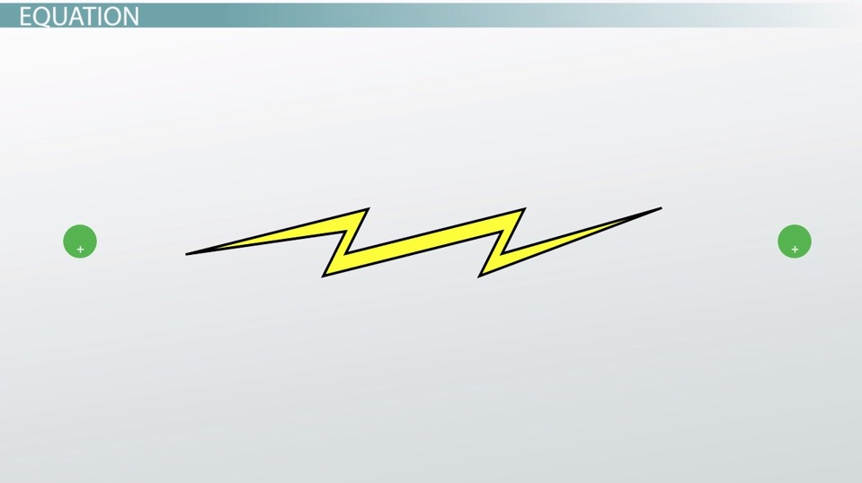
Section 4 – Electric Potential Energy

Slide 2
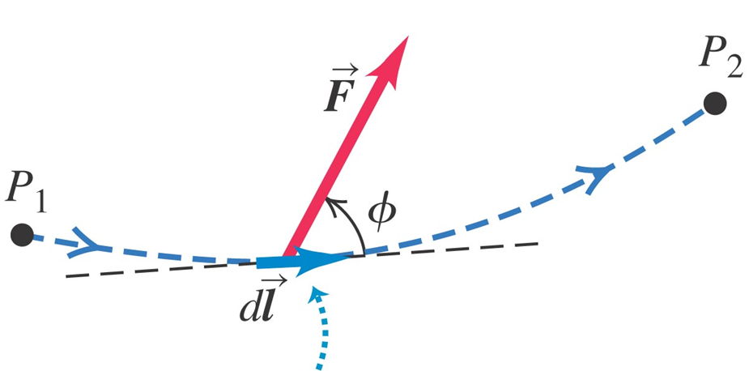

Work, Potential Energy and Force: A Quick Review
$$W≡\int_{P_{1}}^{P_{2}}{\vec{F}·d\vec{r}}$$
$∆U≡−W$
$\vec{F}=−\frac{dU}{dr}\vec{r}$ (in 1D)

Slide 3
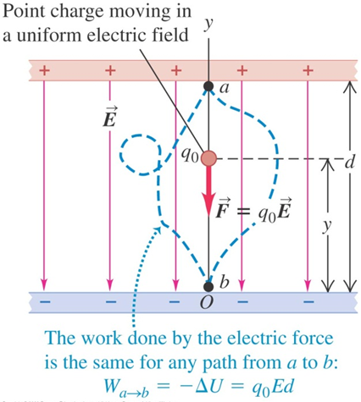
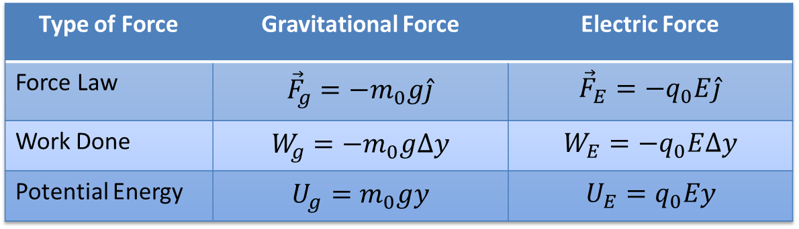
Work and Potential Energy: Uniform Field
Type of Force | Gravitational Force | Electric Force
Force Law | $${\vec{F}}_{g}=−m_{0}g\hat{j}$$ | $${\vec{F}}_{E}=−q_{0}E\hat{j}$$
Work Done | $$W_{g}=−m_{0}g∆y$$ | $$W_{E}=−q_{0}E∆y$$
Potential Energy | $$U_{g}=m_{0}gy$$ | $$U_{E}=q_{0}Ey$$

Slide 4
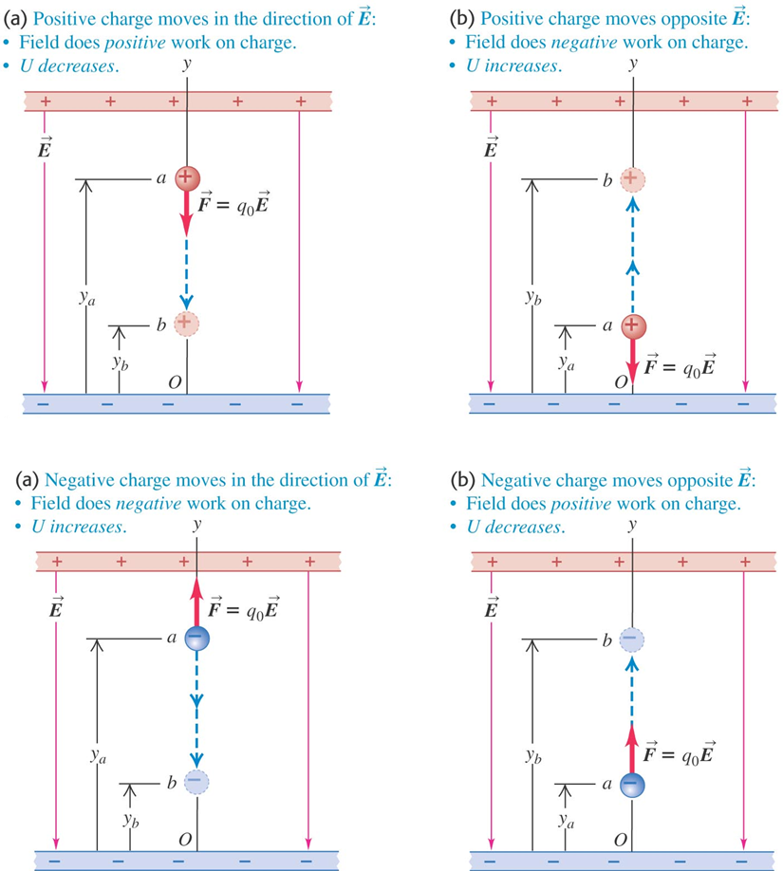

Slide 5
Activity
Analogies between Gravity and the Electric Force: Uniform Field

Slide 6
Example: Uniform Field

Slide 7
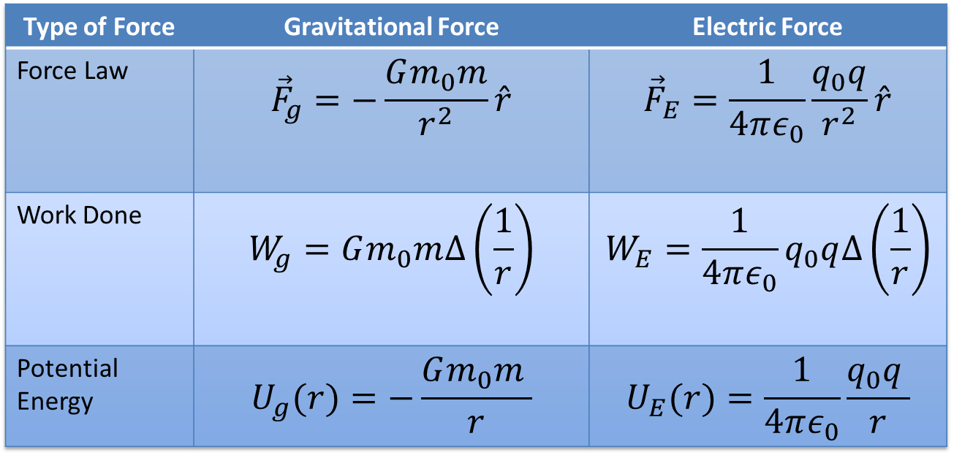
Work and Potential Energy: Two-Point Sources
Type of Force | Gravitational Force | Electric Force
Force Law | $${\vec{F}}_{g}=−\frac{Gm_{0}m}{r^{2}}\hat{r}$$ | $${\vec{F}}_{E}=\frac{1}{4πε_{0}}\frac{q_{0}q}{r^{2}}\hat{r}$$
Work Done | $$W_{g}=Gm_{0}m∆\left(\frac{1}{r}\right)$$ | $$W_{E}=\frac{1}{4πε_{0}}q_{0}q∆\left(\frac{1}{r}\right)$$
Potential Energy | $$U_{g}(r)=−\frac{Gm_{0}m }{r}$$ | $$U_{E}(r)=\frac{1}{4πε_{0}}\frac{q_{0}q }{r}$$

Slide 8
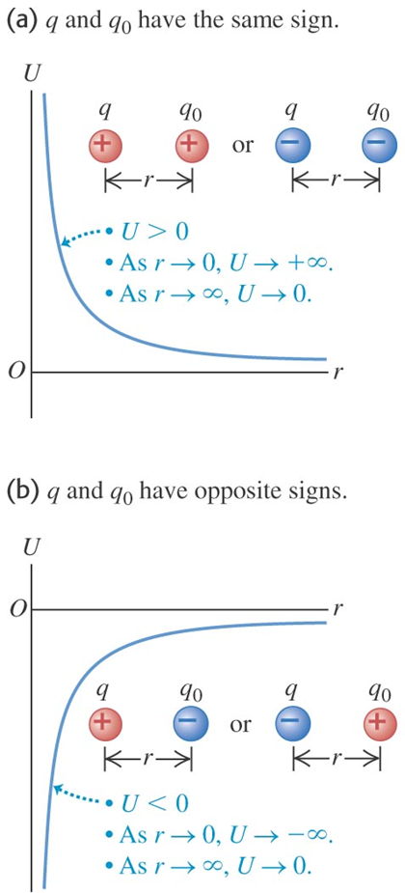
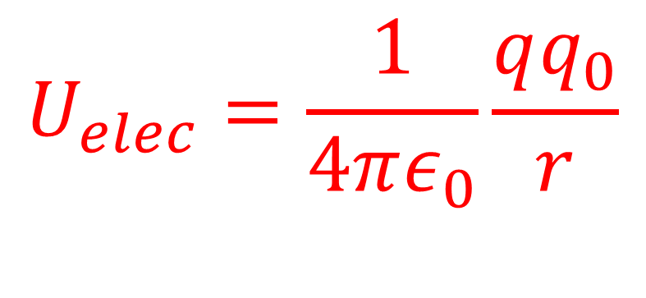
Force and Potential Energy: Energy Diagrams
$$U_{elec}=\frac{1}{4πε_{0}}\frac{qq_{0}}{r}$$

Slide 9
Activity
Analogies between Gravity and the Electric Force: Point Charges

Slide 10
Example: Point Sources

